Slide 1
July Sharing
GCP –
IoT Architecture
Aggy Phang
Aggy.phang@apulsar.com.my
29 Jul 2022

Slide 2
Scope
29 Sep 2022
GCP - Apache
29 Aug 2022
GCP – Vertex AI
Today
GCP – IoT Architecture

Slide 3
Today’s Outline
Overview
BigQuery
Comparison
Case Study
Summary & Finding
Proposal
1
An Overview of GCP – IoT Architecture.
2
BigQuery
3
Comparison of different methods to perform analysis in GCP.
4
Case study
5
Summary and findings
6
Proposed work

Slide 4










Overview of GCP IoT Architecture
Overview
BigQuery
Comparison
Case Study
Summary & Finding
Proposal
Compute function
Data source
Message ingestion service
Analysis
Colab
Cloud Function
Cloud IoT Core
Pub/sub
Dataflow
Big Query
Data Studio
Data processing
Visualization
Device management
ML engine
Advance analysis

Slide 5
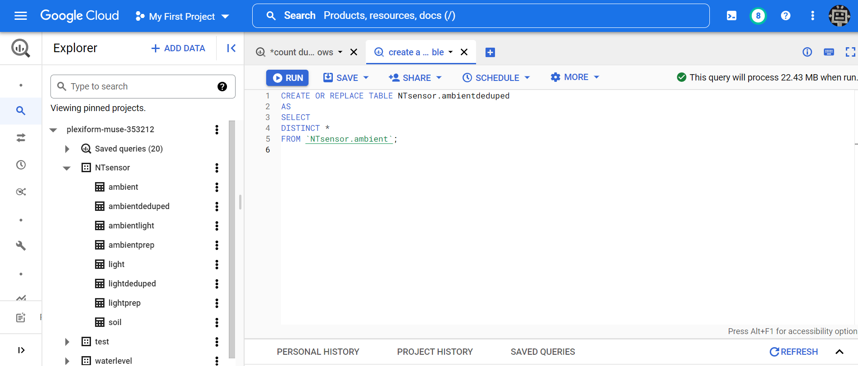
BigQuery
Overview
BigQuery
Comparison
Case Study
Summary & Finding
Proposal
Project ID
Query size
Dataset
Table

Slide 6

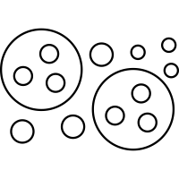

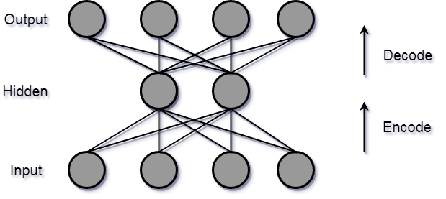

BigQuery
Overview
BigQuery
Comparison
Case Study
Summary & Finding
Proposal
SQL Analysis
BigQueryML
Supported ML models in BigQuery ML
Supervised Learning
Unsupervised Learning
Regression
Clustering
Linear regression
Deep Neural network
K-means clustering
Classification
Logistic regression
Multiclass logistic regression
Deep Neural Network
Autoencoder
Anomaly detection
Ensemble
Boosted tree classification
Boosted tree regression

Slide 7
Comparison of different methods
Overview
BigQuery
Comparison
Case Study
Summary & Finding
Proposal
 | Compute engine | BigQuery | Big Query integrate with google colab
Advantages | Customize machine type and services. | No need to consider infrastructure. No need to install any software or tools. Run complex queries fast. | Can use python data science tools libraries like pandas, numpy, seaborn etc.
Disadvantages | Unpredictable workload, does not fit with current infrastructure. Need to turn off the instance to prevent extra cost. | Restricted to SQL query No libraries can be used | Comparatively slower than bigquery.
Cost | Pay per hour instance running. Price vary based on machine types | Pay per query $5 per TB. Storage $0.02 per GB, per month. first 1 TB of query data processed each month is free. | Pay per query $5 per TB from BigQuery. Free for google colab.

Slide 8
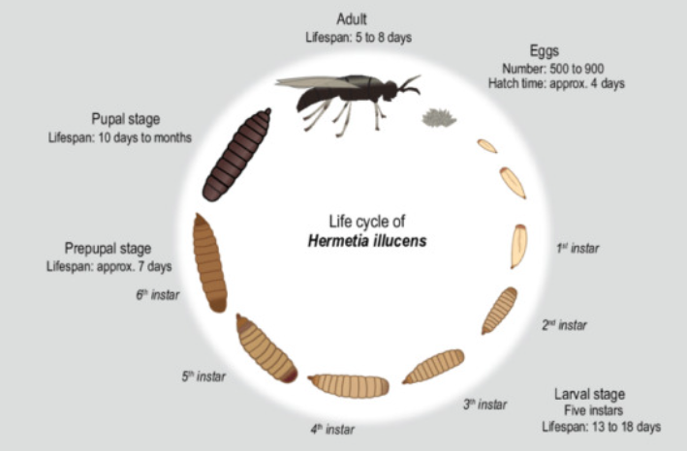
Case Study – NT sensor data
Overview
BigQuery
Comparison
Case Study
Summary & Finding
Proposal
Problem background:
Black soldier fly (BSF) larvae is highly valuable alternative sources of protein for animal feed.They also feed on substrate (waste product); this greatly reduce waste. The main aim is to ensure optimal growth of BSF, maximize production of BSF larvae and its nutrition composition.
Dataset:
Environment condition data from sensors
Ambient & Light condition - Insectary (adult mating, laying egg)
Ambient & Soil condition - Warehouse (larvae)

Slide 9
Case Study – NT sensor data
Overview
BigQuery
Comparison
Case Study
Summary & Finding
Proposal
Approach:
1. Literature review related work.
2. Exploratory Data Analysis (EDA) on available environment data.
3. Clustering to identify similar group of data.
Tool:
Bigquery, Google Colab

Slide 10
Literature review related work
Overview
BigQuery
Comparison
Case Study
Summary & Finding
Proposal
Findings
BSF mating is influenced by light and temperature.
Temperatures below and above the minimum and maximum threshold of 15 °C and 40 °C, are shown to be unfavorable for the growth of BSF in all its life stages. Ideal temperature for BSF larvae to successfully nurture is in between the range of 24–30 °C.
BSF larvae develop most rapidly at 70% humidity, Weight loss increased with decreasing humidity. Optimal BSF mating is around 30% – 90%
BSF LED lamps (specially designed lamps based on BSF adult visual spectral sensitivity) provided to be the most energy-efficient light source and also produced the highest mating success rate based on inseminated females.
pH plays a minor factor in BSF larvae development
In a small-scale environment, living space is also an important criterion to ensure BSF larvae can be nurtured successfully. Sufficient spacing helps to improve life-history traits
Paper | Aim | Finding | Key factor
Kristianto et al. 2022 | Control temperature, light intensity, and humidity in the breeding site. | Produce more eggs. | Temperature, humidity
Ceccotti et al. 2022 | Determine whether BSG substrate are optimal for larval growth and development | larvae reared on BSG + S. limacinum substrate reached prepupal stage earlier. | diet
Van et al. 2022 | Automated smart farming to rear BSF | Optimal range of temperature | Temp, humidity, pH
Liu et al. 2020 | Compare 4 different artificial light sources on BSF mating success | BSFLED light led to highest mating success | Light intensity
Chia et al. 2018 | Temperature and diet effect on development and survivor rate of BSF life stages | Rate of black soldier fly growth and development was considerably influenced by temperature and diet | Temperature, diet

Slide 11
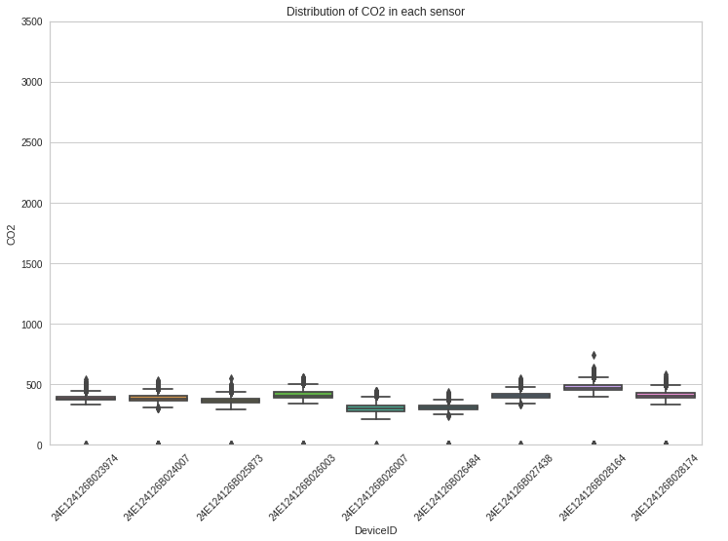
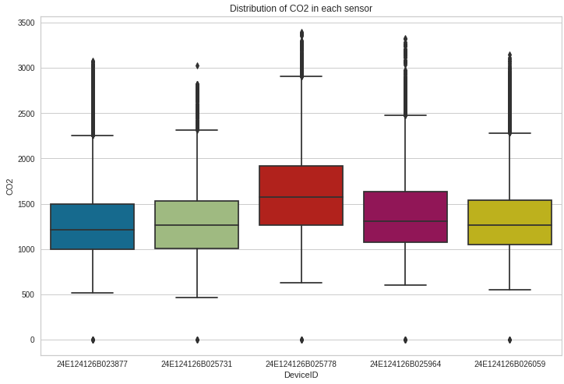
EDA (distribution)
Overview
BigQuery
Comparison
Case Study
Summary & Finding
Proposal
CO2
Insectary
Warehouse (larvae)
Insights: CO2 level is relatively low in insectary compared in warehouse.
Hypothesis : Composting food waste by BSF larvae emit CO2. The higher the CO2, the more nutrition composition in BSF larvae.

Slide 12
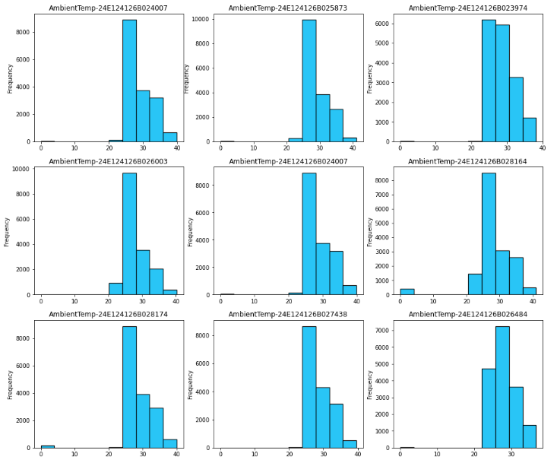
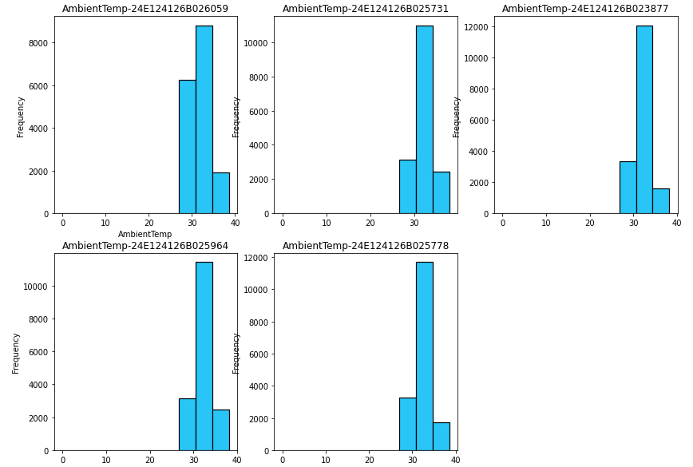
EDA (distribution)
Overview
BigQuery
Comparison
Case Study
Summary & Finding
Proposal
AmbientTemp
Insectary
Warehouse (larvae)
Insights: Temperature in Insectary is sometimes lower.
Hypothesis : Insectary and warehouse have different temperature requirement.

Slide 13
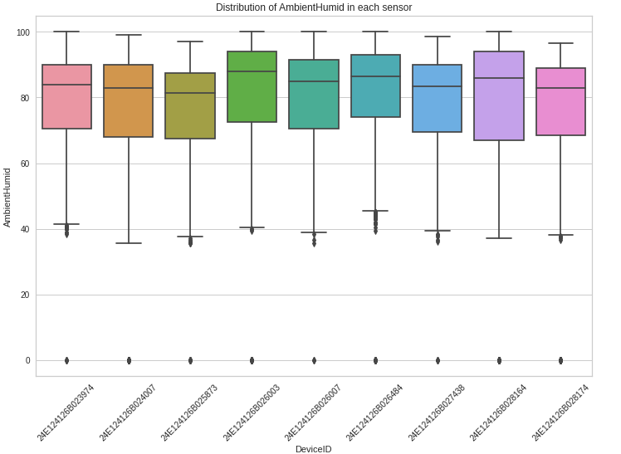
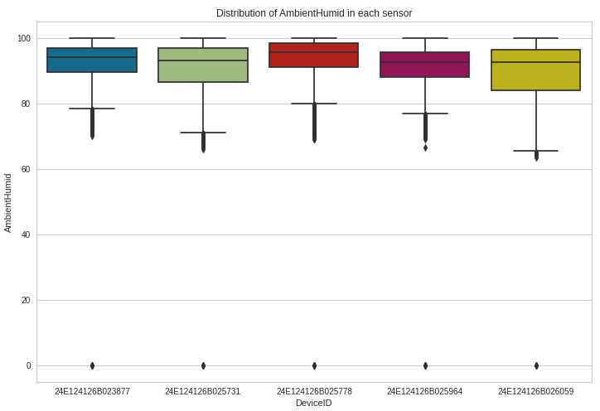
EDA (distribution)
Overview
BigQuery
Comparison
Case Study
Summary & Finding
Proposal
AmbientHumid
Insectary
Warehouse (larvae)
Insights: Humidity in Insectary is lower than in Warehouse and is more spread.
Hypothesis : Insectary and warehouse have different humidity requirement.

Slide 14
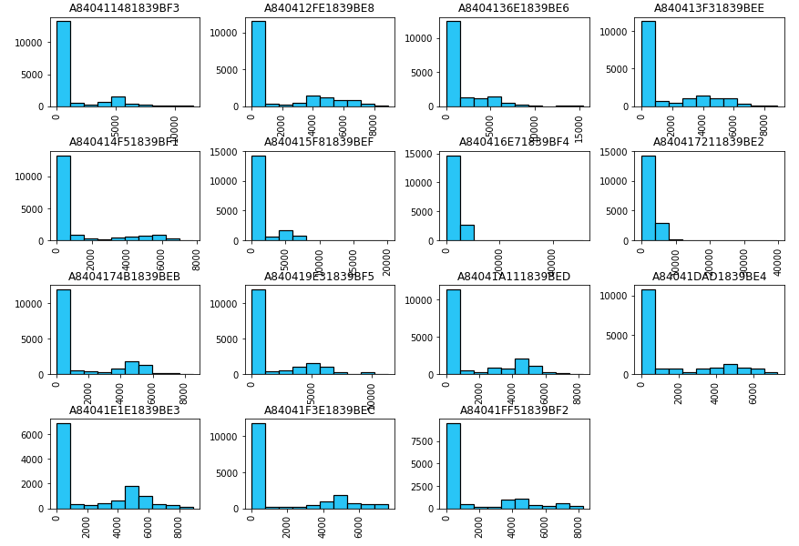
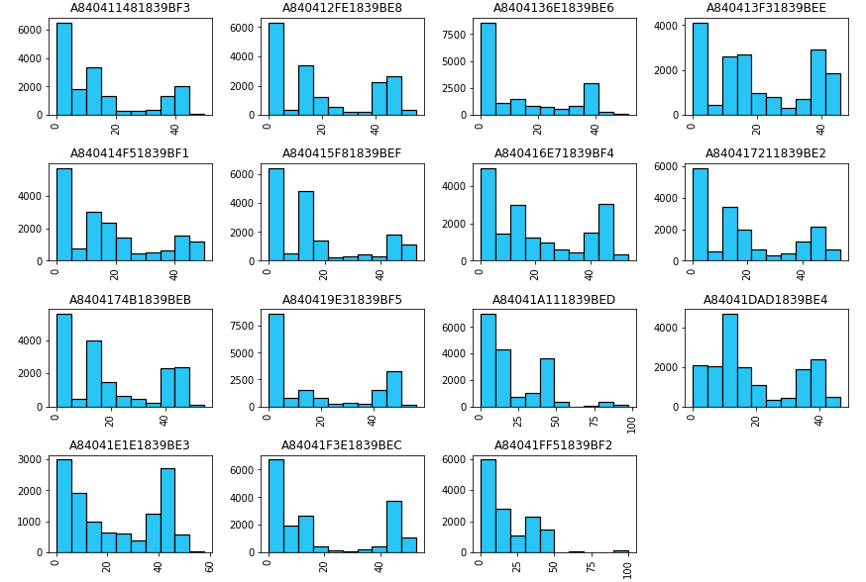
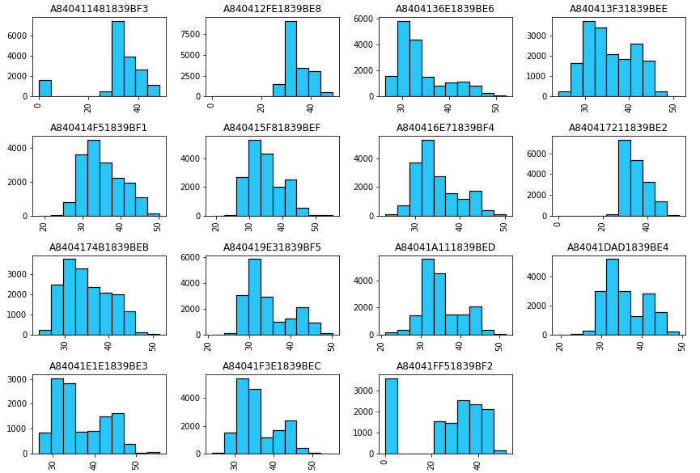
EDA (distribution)
Overview
BigQuery
Comparison
Case Study
Summary & Finding
Proposal
Warehouse (larvae)
SoilEC
SoilMoisture
SoilTemp
Insights: Soil Moisture has multimodal distribution.
Hypothesis: Soil moisture prevent pupae turn into fly.

Slide 15
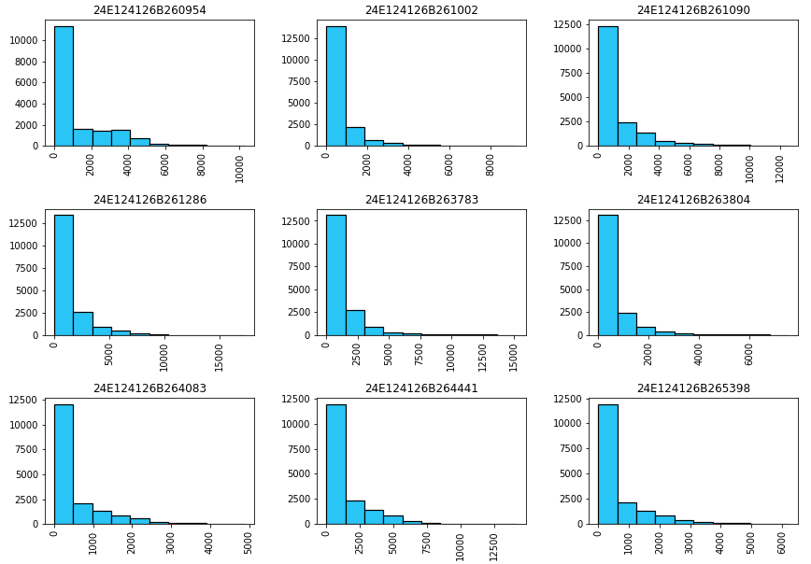
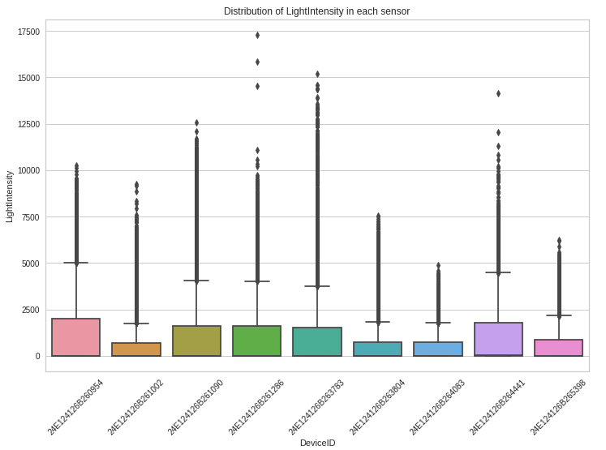
EDA (distribution)
Overview
BigQuery
Comparison
Case Study
Summary & Finding
Proposal
Insectary
LightIntensity
Insight: The light intensity has many extreme values.
Hypothesis: The light intensity can affect BSF mating.

Slide 16
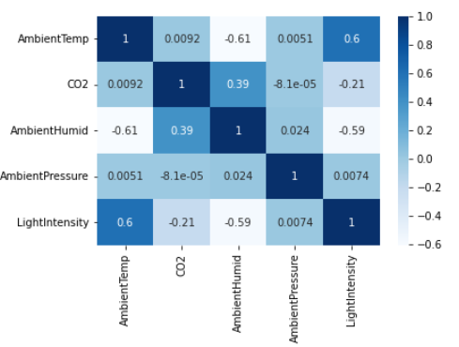
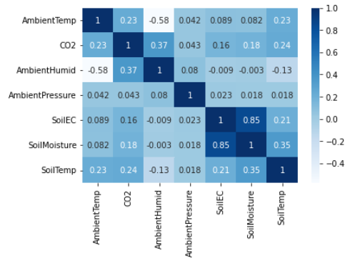
EDA (correlation)
Overview
BigQuery
Comparison
Case Study
Summary & Finding
Proposal
Insectary
Warehouse (larvae)
Insight:
There is relationship between temperature and light, temperature and humid, soilEC and soilMoisture.
Hypothesis
Increase of light intensity can result in the increase of temperature.
As ambient temperature increases, the humidity decreases.

Slide 17
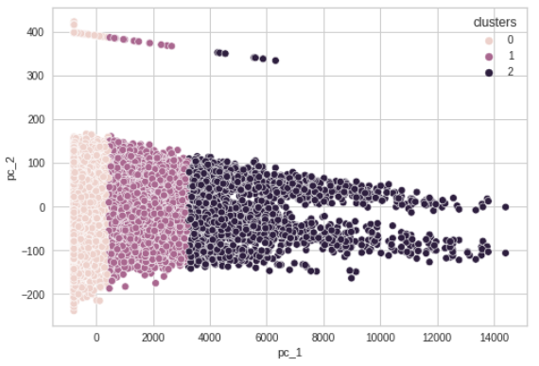
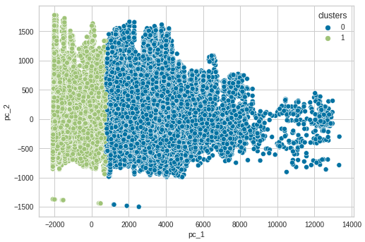
Clustering
Overview
BigQuery
Comparison
Case Study
Summary & Finding
Proposal
Insectary
Warehouse (larvae)
Cluster 1
Cluster 2
Cluster 3
Cluster 1
Cluster 2
AmbientTemp | 27.3
CO2 | 391.74
AmbientHumid | 84.17
AmbientPressure | 1007.29
LightIntensity | 169.47
AmbientTemp | 32.5
CO2 | 371.06
AmbientHumid | 65.32
AmbientPressure | 1007.97
LightIntensity | 2256.81
AmbientTemp | 33.57
CO2 | 348.22
AmbientHumid | 59.45
AmbientPressure | 1007.81
LightIntensity | 5790.58
AmbientTemp | 32.36
CO2 | 1524.58
AmbientHumid | 90.37
AmbientPressure | 1009.06
SoilEC | 5370.72
SoilMoisture | 42.38
AmbientTemp | 31.98
CO2 | 1376.42
AmbientHumid | 90.67
AmbientPressure | 1008.42
SoilEC | 310.67
SoilMoisture | 10.63

Slide 18
Summary and Findings
Overview
BigQuery
Comparison
Case Study
Summary & Finding
Proposal
Research
Environment condition can cause BSF mating slows, resulting in an irregular generation of eggs.
BSF mating is influenced by light and temperature.
Temperatures below and above the minimum and maximum threshold of 15 °C and 40 °C, are shown to be unfavorable for the growth of BSF in all its life stages.
Ideal temperature for BSF larvae to successfully nurture is in between the range of 24–30 °C
BSF LED lamps (specially designed lamps based on BSF adult visual spectral sensitivity) provided to be the most energy-efficient light source and also produced the highest mating success rate based on inseminated females.
EDA on environmental sensors data
There are different distribution of ambient condition between insectary and warehouse.
The CO2 in insectary is relatively low than in warehouse.
There is relationship between temperature and light, temperature and humid, soilEC and soilMoisture
Clustering
Discovered 3 groups of environmental condition in insectory which based on the light intensity. (low, medium, high).
Discovered 2 groups of environmental condition in warehouse which based on the soil condition.

Slide 19
Proposed work
Overview
BigQuery
Comparison
Case Study
Summary & Finding
Proposal
Proposed work | Data
Automatic control and maintain the optimal level of environment condition for different BSF life stage. (mating, larvae development). | Ambient data light data Soil data optimal level of ambient and light intensity, soil moisture.
Determine whether BSF larvae obtain enough nutrition. | CO2 level data
Predict metamorphosis of pupae to adult fly based on soil moisture. (Determine the optimal ratio turning into adult and use as animal feed). | Soil Moisture level data
Maximize the nutrition composition of larvae based on the rearing substrate. | Type of feed/diet Frequency of feeding Quantity of feed/diet

Slide 20
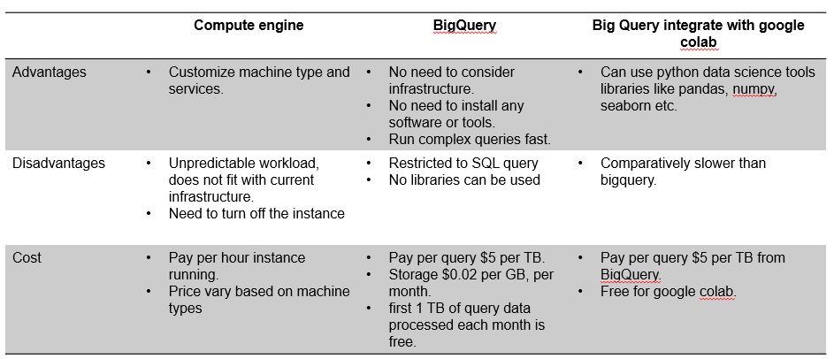
Next Sharing
Overview
BigQuery
Dataprep
Case Study 1
Case Study 2
References
29 Sep 2022
GCP - Apache
29 Aug 2022
GCP – Vertex AI
Predictive modelling
Machine learning

Slide 21
References
Overview
BigQuery
Dataprep
Case Study 1
Case Study 2
References
BigQuery Pricing https://cloud.google.com/bigquery/pricing
Kristianto et al. 2022 Automated IoT Device to Manipulate Environmental Condition of Black Soldier Fly
Chia SY, Tanga CM, Khamis FM, Mohamed SA, Salifu D, Sevgan S, et al. (2018) Threshold temperatures and thermal requirements of black soldier fly Hermetia illucens: Implications for mass production. PLoS ONE 13(11): e0206097
Ceccotti, C., Bruno, D., Tettamanti, G., Branduardi, P., Bertacchi, S., Labra, M., ... & Terova, G. (2022). New value from food and industrial wastes–Bioaccumulation of omega-3 fatty acids from an oleaginous microbial biomass paired with a brewery by-product using black soldier fly (Hermetia illucens) larvae. Waste Management, 143, 95-104.
Liu, Z., Najar-Rodriguez, A. J., Minor, M. A., Hedderley, D. I., & Morel, P. C. (2020). Mating success of the black soldier fly, Hermetia illucens (Diptera: Stratiomyidae), under four artificial light sources. Journal of Photochemistry and Photobiology B: Biology, 205, 111815.
Van, J. C. F., Tham, P. E., Lim, H. R., Khoo, K. S., Chang, J. S., & Show, P. L. (2022). Integration of Internet-of-Things as sustainable smart farming technology for the rearing of black soldier fly to mitigate food waste. Journal of the Taiwan Institute of Chemical Engineers, 104235.

Slide 22
Thank You

Slide 23
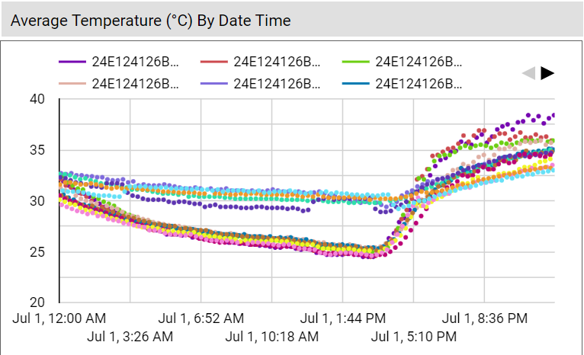
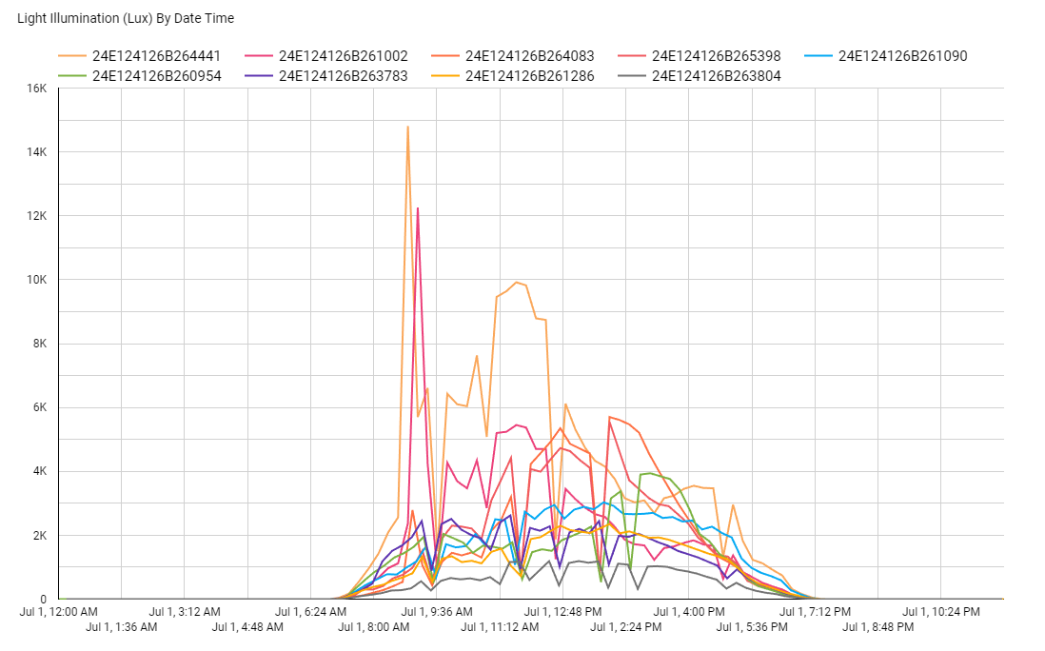
EDA (across time)
Overview
BigQuery
Comparison
Case Study
Summary & Finding
Suggestion

